Slide 1
Augmented Reality in Gaming
By Daniel Elstob

Slide 2
What is Augmented Reality?
Combination of real world and virtual images (Azuma 1997)
Both can be viewed at the same time
Real-time interaction (Azuma 1997)
Virtual images can be interacted with
Registered in 3D (Azuma 1997)
Virtual object appear fixed in space

Slide 3
How Augmented Reality works
There are two types of augmented reality (Johnson et al, 2010):
Marker-Based
Uses visual cues that when detected by a camera runs the correct software
Markerless
Uses positional data like GPS and compass

Slide 4
Augmented Reality vs Virtual Reality
Augmented Reality: Enhances Reality
Non-immersive
Small FOV
Minimal rendering
Virtual Reality: Replaces Reality
Immersive
Wide FOV
Requires realistic images

Slide 5
Smartphones

Slide 6
Smartphones
Mobile Augmented Reality revenue in 2013 was more than $180m
40% of Augmented Reality downloads in 2013 were games (CBR 2014)
Mobile Augmented Reality revenue is expected to reach $1.2bn by 2015 (CBR 2014)

Slide 7

Android
Controlled 81.3% of the market in Q3 2013 (Protalinski 2013)
Controlled 78.9% of the market in Q4 2013 (Protalinski 2014)
1 billion devices activated (Gundotra 2013)
Figure 1

Slide 8
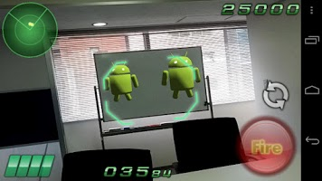
DroidShooting
A shooting game developed by Quest-Com Co., Ltd
One of the most popular augmented reality games
Users navigate the game through tilting the camera

Slide 9
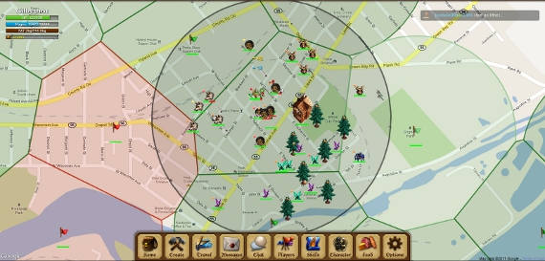
Parallel Kingdom
An massively multiplayer online game developed by PerBlue
Turns Google maps into a large-scale medieval map of kingdoms

Slide 10
http://allfacebook.com/files/2012/01/ParallelKingdomHunting.jpg

Slide 11

Ingress
Near real-time massively multiplayer online pervasive game developed by Niantic Labs
Gameplay consists of establishing “portals” at places of public art, landmarks, etc. and linking them together
Progress is measured by the number of people controlled by each fraction

Slide 12
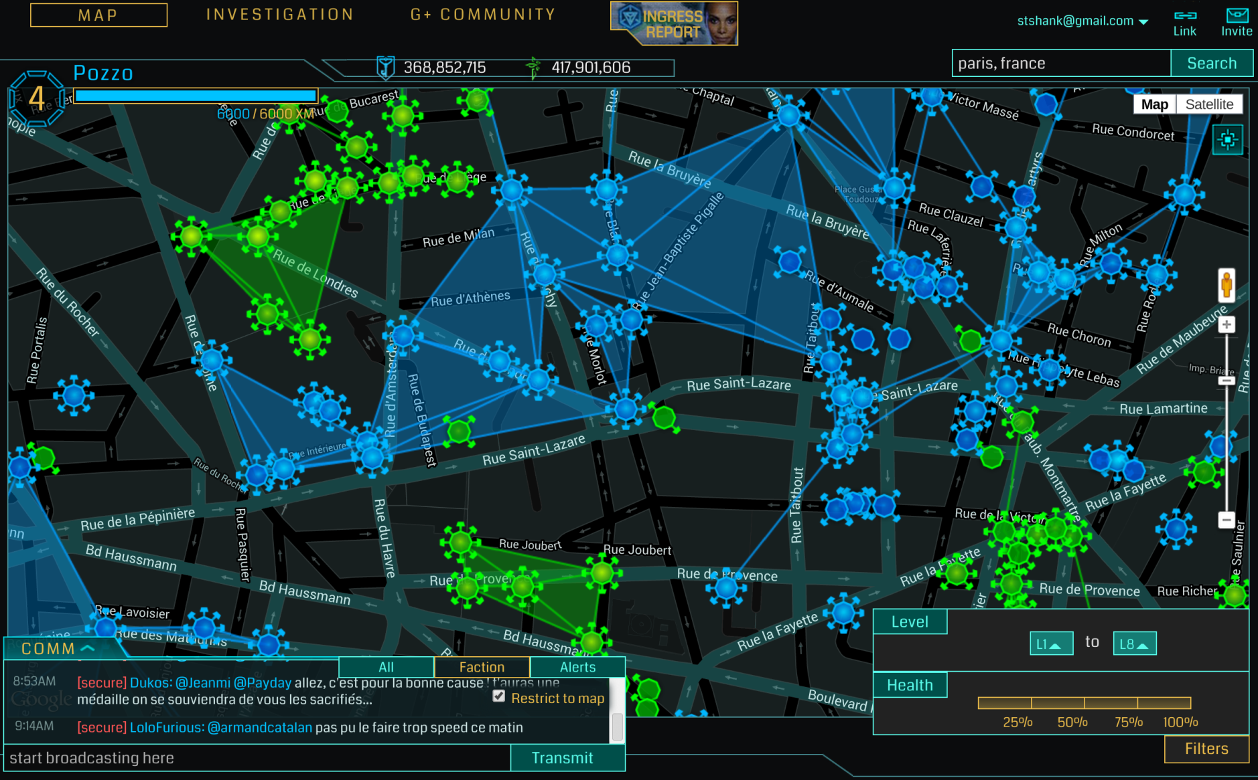

Slide 13
SpecTrek
A ghost hunting game developed by SpecTrekking
Designed to give the user a work-out while playing
Three default game modes; 15, 30 and 60 minutes
SpecTrek projects ghost at various locations on a Google map within a radius
User must get to ghosts and capture them through their cameras

Slide 14
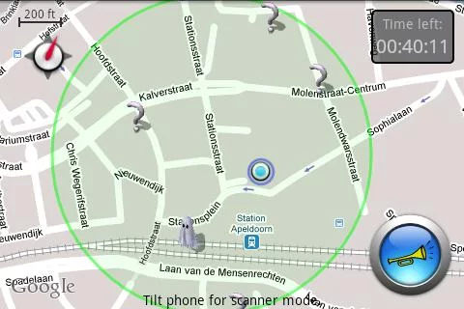
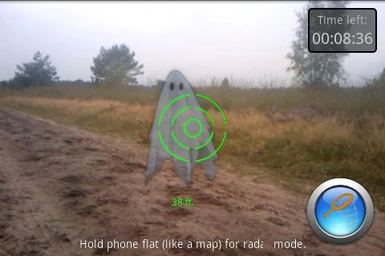

Slide 15

IOS
Controlled 13.4% of the market in Q3 2013 (Protalinski 2013)
Controlled 15.5% of the market in Q4 2013 (Protalinski 2014)
700 million devices (Dediu 2013)

Slide 16
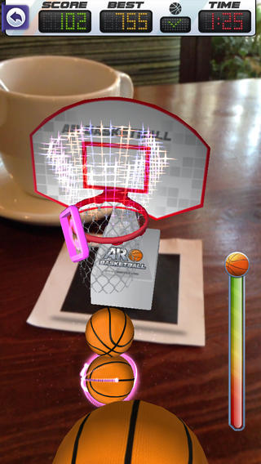
AR Basketball
An augmented reality basketball game developed by Augmented Pixels Co Ltd
Requires a printed marker to create the augmented hoop

Slide 17

Zombies Everywhere!
An augmented reality zombie apocalypse developed by Useless Creations Pty Ltd
Uses the surrounding real world environment as virtual world’s background
Aiming is controlled by the devices positioning and movement

Slide 18
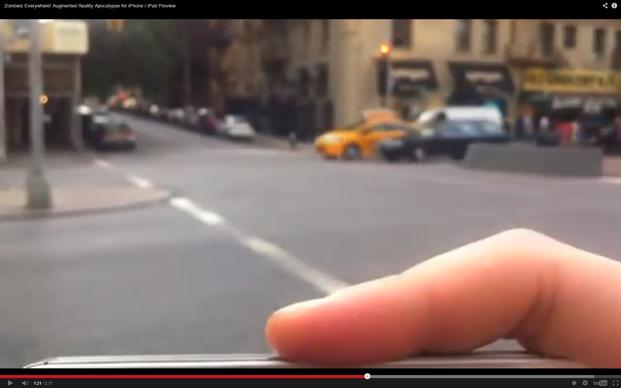
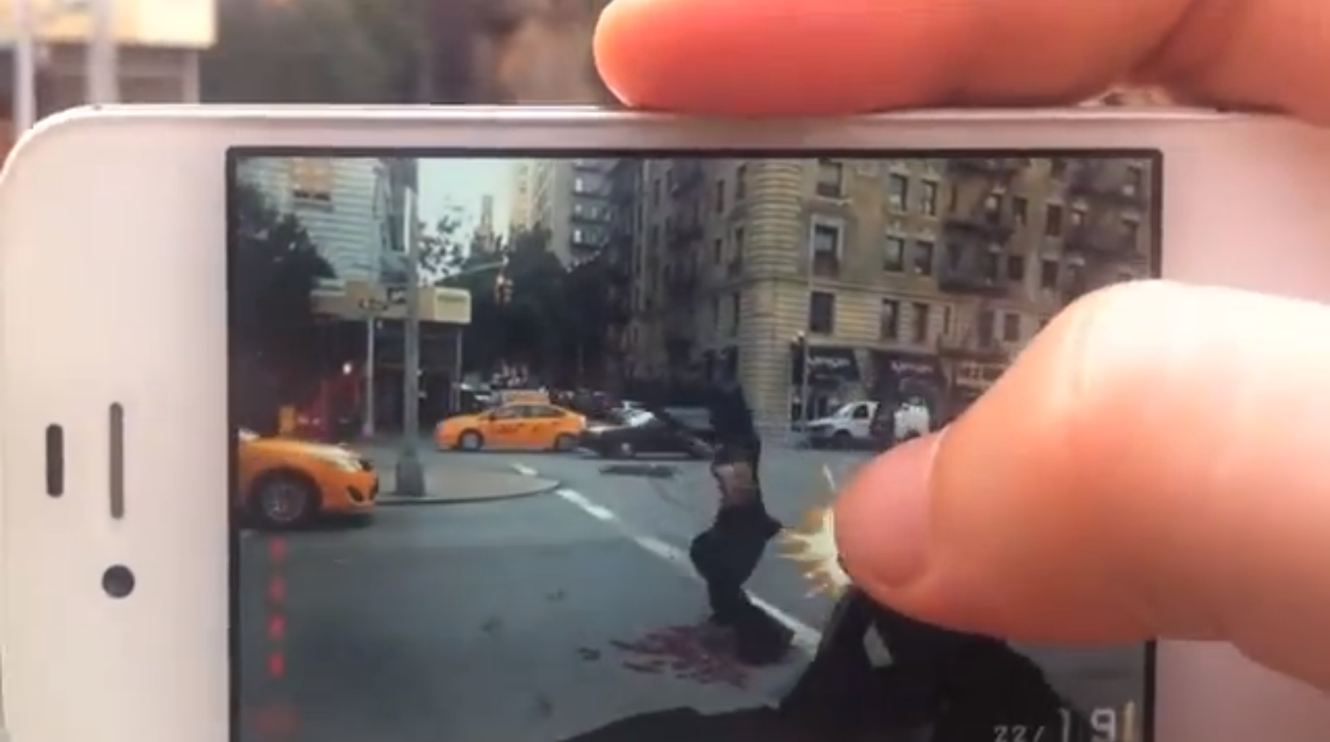

Slide 19
Both ios and andriod
Ar invaders
Toyota 86
paintball

Slide 20
Google Glass

Slide 21
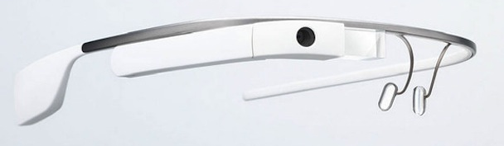
Google Glass
A wearable computer with an optical head-mounted display
Currently in development
Aims to become a product for ubiquitous computing

Slide 22

Race Yourself
Developed by Glassfit
30 game modes
Running against yourself
Running against friends
Running in virtual marathon
Running from zombies
Promotes fitness
Visual improvements during workout
Race friends
Similar to apps SpecTrek

Slide 23
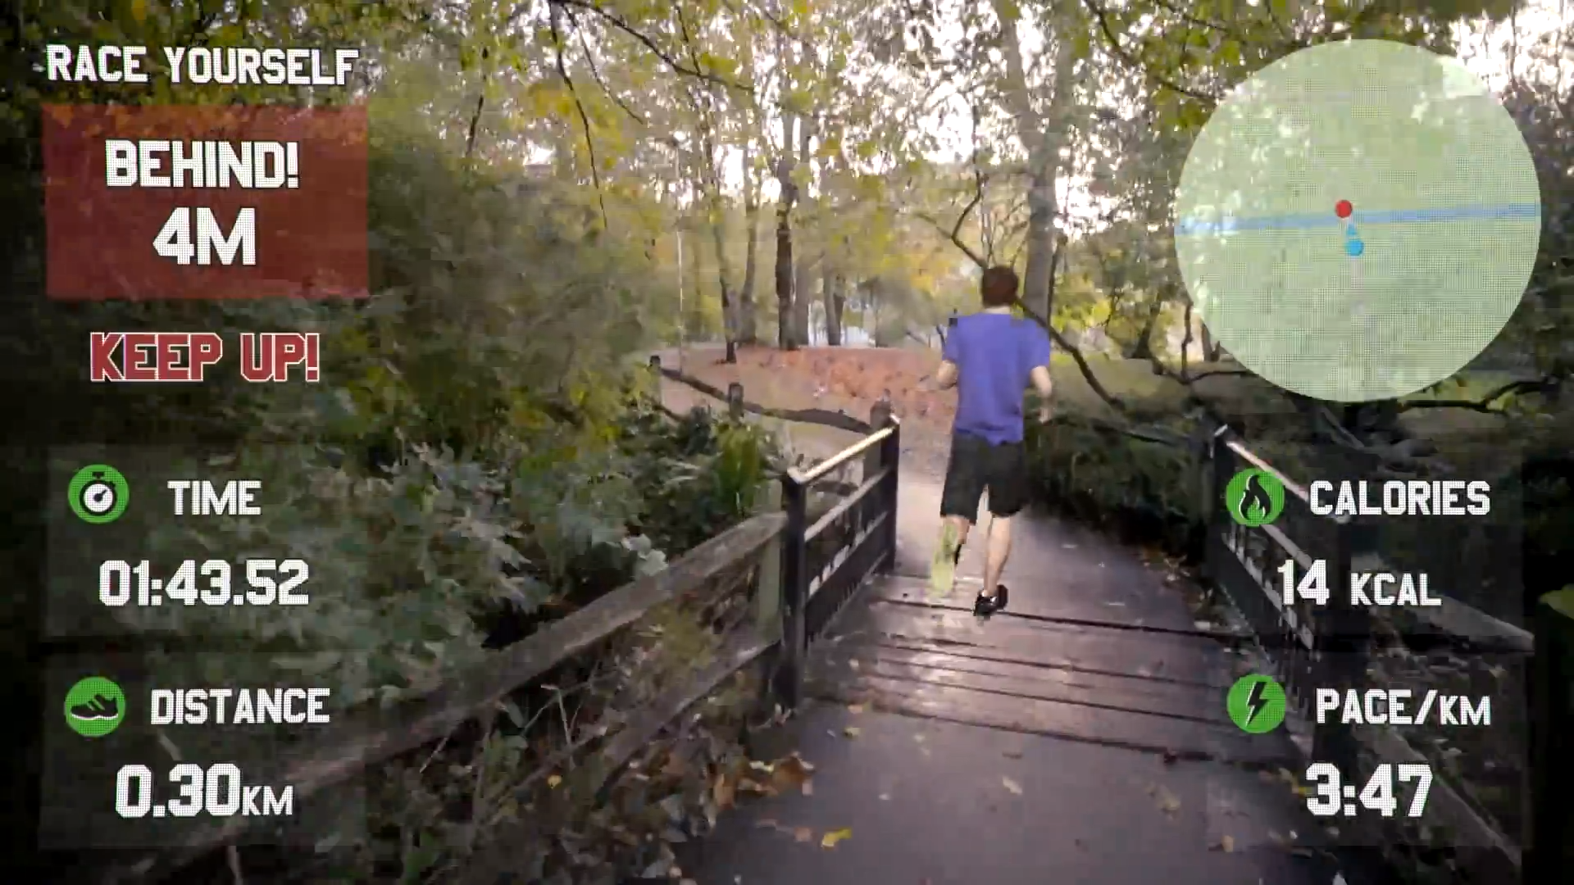

Slide 24
Future Developments

Slide 25
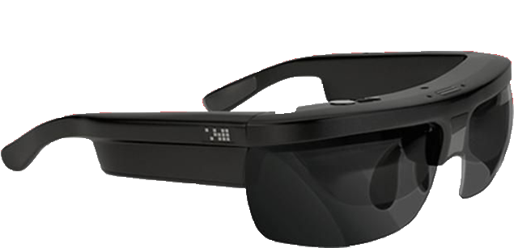
Microsoft
Paid up to $150 million for 6 already-issued and 75 in-progress patents (TotalXbox 2014)
In 2012 an Xbox roadmap leaked plans for glasses called “Kinetic Shades”
Osterhout’s Augmented Reality headset prototype

Slide 26
Vuzix M100

Slide 27
Summary
Advantage/disadvantage?

Slide 28
Questions?

Slide 29
References
Azuma, R. T. (1997). A survey of augmented reality. Presence, 6(4), 355-385. Retrieved from http://www.cs.unc.edu/~azuma/ARpresence.pdf
Johnson, L., Levine, A., Smith, R. & Stone, S. (2010). Simple augmented reality. The 2010 Horizon Report 21-24. Austin, TX: The New Media Consortium Retrieved from http://www.nmc.org/pdf/2010-Horizon-Report.pdf
CBR (2014) Games to boost mobile AR revenue to $1.2bn by 2015 Retrieved from http://www.cbronline.com/news/social/mobile-augmented-reality-revenue-to-reach-12bn-by-2015-050214-4172040
Protalinski, E. (2013) Strategy Analytics: Android smartphone shipments up to 81.3% in Q3 2013, iOS down to 13.4%, Windows Phone at 4.1% Retrieved from http://thenextweb.com/mobile/2013/10/31/strategy-analytics-android-smartphone-shipments-81-3-q3-2013-ios-13-4-windows-phone-4-1/
Protalinski, E. (2014) Strategy Analytics: Android smartphone shipments up to 78.9% in 2013, iOS down to 15.5%, Windows Phone at 3.6% Retrieved from http://thenextweb.com/mobile/2014/01/29/strategy-analytics-android-smartphone-shipments-78-9-2013-ios-15-5-windows-phone-3-6/
Gundotra, V. (2014) Retrieved from https://plus.google.com/+VicGundotra/posts/8CVJ79nPQwN
DroidShooting (2012) Retrieved from https://play.google.com/store/apps/details?id=jp.co.questcom.droidshooting

Slide 30
References Continued 1
Parrallel Kingdom (2013) Retrieved from https://play.google.com/store/apps/details?id=com.silvermoon.client
Ingress (2013) Retrieved from https://support.google.com/ingress/answer/2799239?hl=en&ref_topic=2799231
SpecTrek (2014) Retrieved from https://play.google.com/store/apps/details?id=com.spectrekking.full
Dediu, H. (2013) Retrieved from http://www.asymco.com/2013/11/25/one-billion-ios-devices/
ARBasketball (2013) Retrieved from https://itunes.apple.com/gb/app/arbasketball-augmented-reality/id393333529?mt=8
Zombies Everywhere! (2013) Retrieved from http://www.youtube.com/watch?v=Ce1U_9DRcac&list=UU-n5OXuy97Gigu22Qzpq5vA
Race Yourself (2014) Retrieved from http://raceyourself.com/
TotalXbox (2014) Retrieved from http://www.totalxbox.com/74099/microsoft-buys-ar-headset-patents-for-100-150-million-report/

Slide 31
References Continued 2
Figure 1: Android Logo (2013) Retrieved from http://blog.appliedis.com/wp-content/uploads/2013/11/android1.png
Figure 2: DroidShooting (20) Retrieved from http://www.zwodnik.com/media/images/droidshooting_android_2.jpeg
Figure 3 http://allfacebook.com/files/2012/01/ParallelKingdomHunting.jpg
Figure 4 http://upload.wikimedia.org/wikipedia/commons/6/63/Ingress_Logo.png
Figure 5 http://cnet4.cbsistatic.com/hub/i/2013/10/14/0b54021b-4de3-11e3-945a-14feb5ca9861/ed5ef0d8c03e2734b4778dac473790bf/Ingress_Screenshot_2013-10-14.png
Figure 6 Screenshots retrieved from https://play.google.com/store/apps/details?id=com.spectrekking.full
Figure 7 http://www.spoonjuice.com/wp-content/uploads/2011/06/ios_51.jpg
Figure 8 https://itunes.apple.com/gb/app/arbasketball-augmented-reality/id393333529?mt=8
Figure 9 http://a2.mzstatic.com/us/r30/Purple/v4/e7/96/8c/e7968cc7-a537-98a2-d0f7-156a8fcd21ba/mzl.urskbzeg.png
Figure 10 http://www.youtube.com/watch?v=Ce1U_9DRcac&list=UU-n5OXuy97Gigu22Qzpq5vA

Slide 32
References Continued 3
Figure 11 http://cdn.stereogum.com/files/2013/11/Google-Glass.jpg
Figure 12 http://c93fea60bb98e121740fc38ff31162a8.s3.amazonaws.com/wp-content/uploads/2013/10/race-yourself.jpg
Figure 13 http://www.youtube.com/watch?v=39W6CMpdGsM#t=30
Figure 14 CBR (2014) Games to boost mobile AR revenue to $1.2bn by 2015 Retrieved from http://www.cbronline.com/news/social/mobile-augmented-reality-revenue-to-reach-12bn-by-2015-050214-4172040

